Slide 1



Slide 2
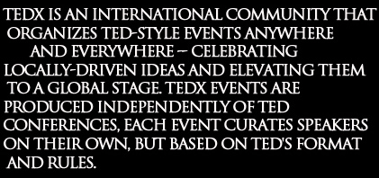
TEDx

Slide 3
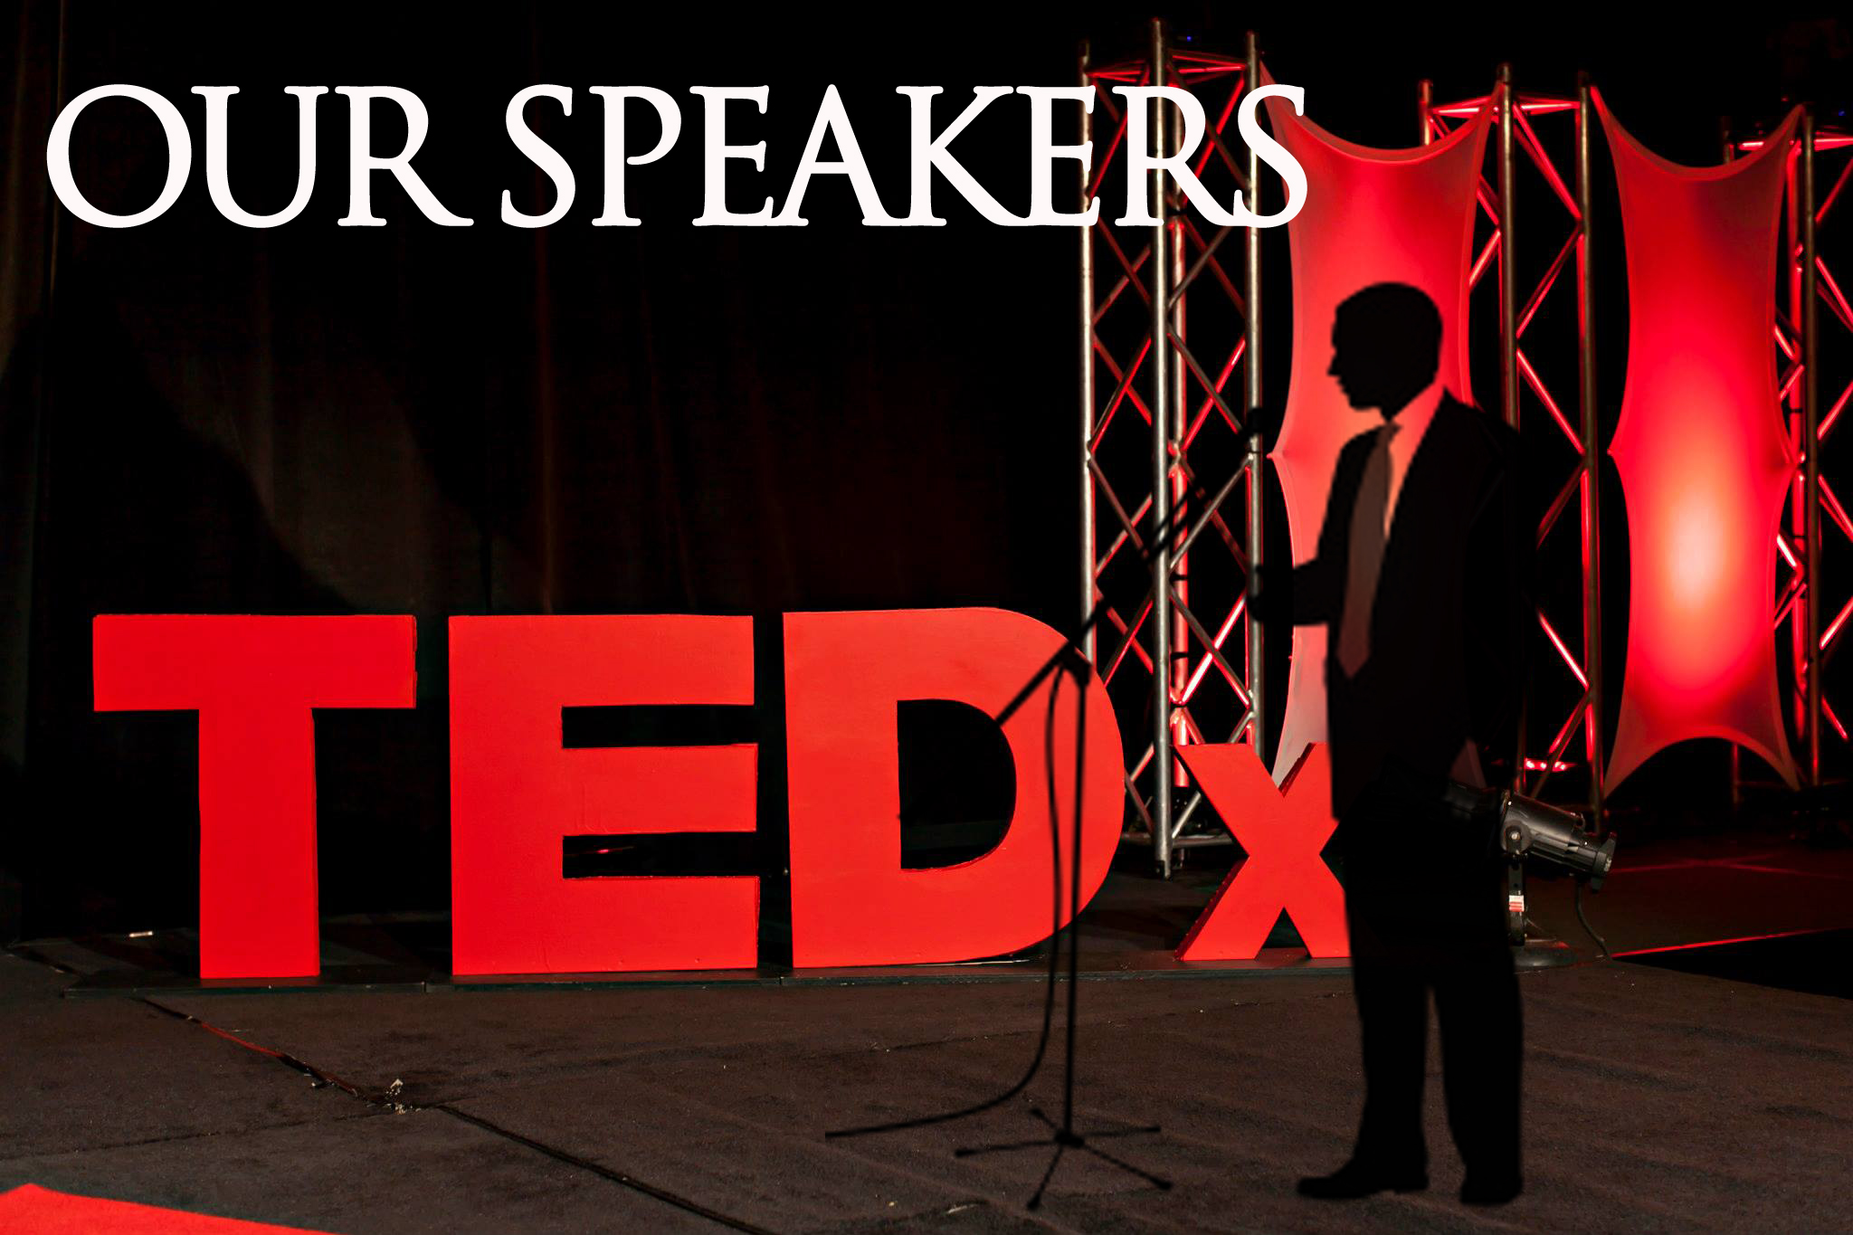

Slide 4
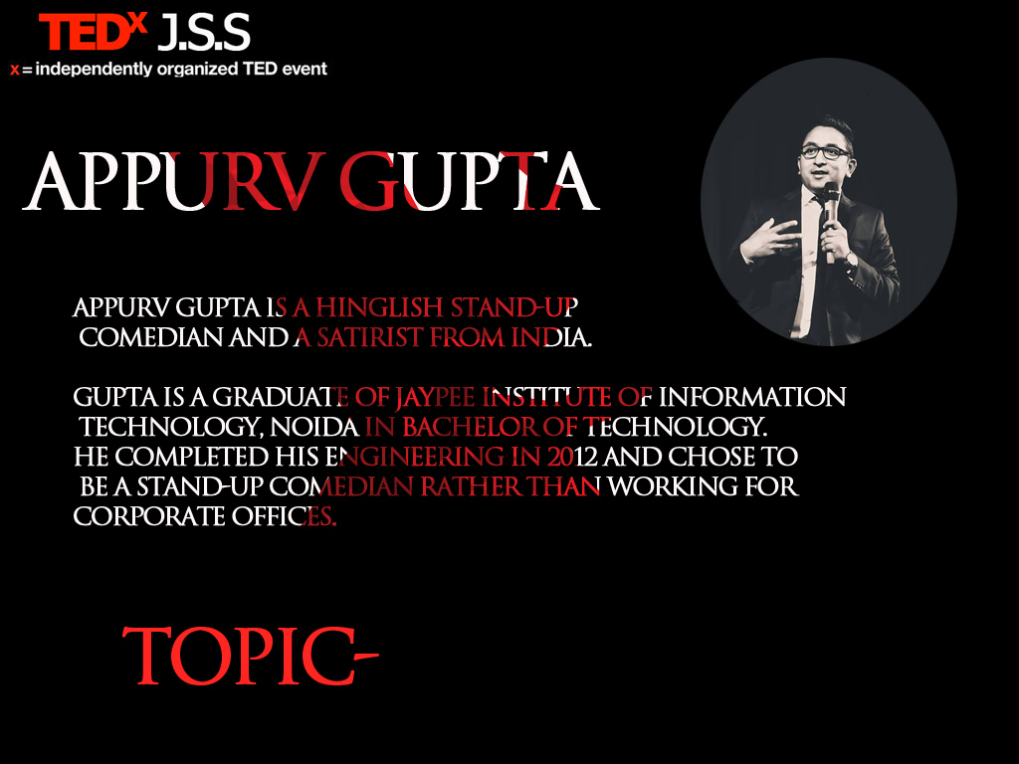

Slide 5
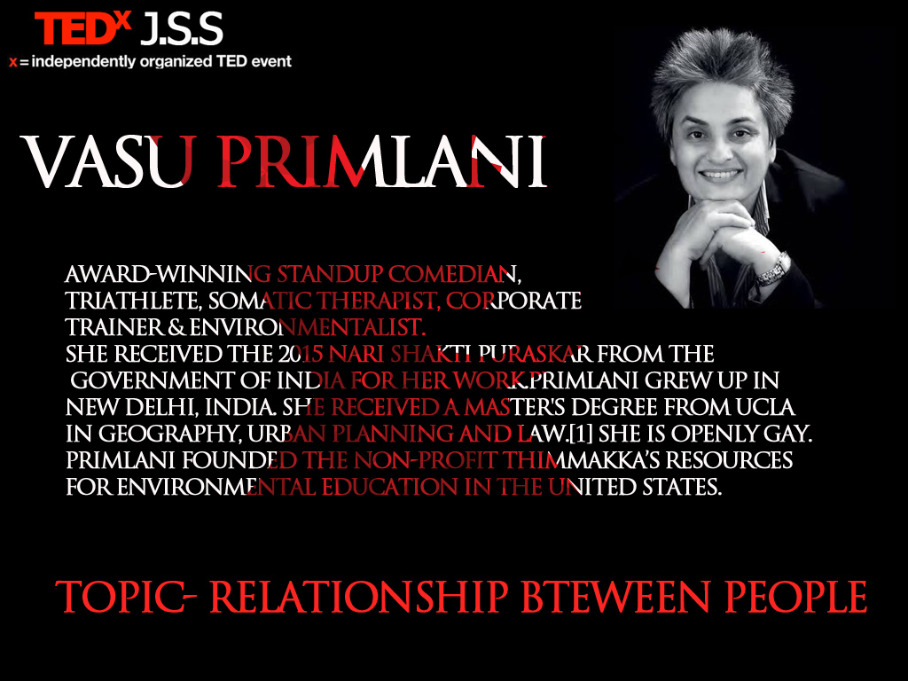

Slide 6


Slide 7
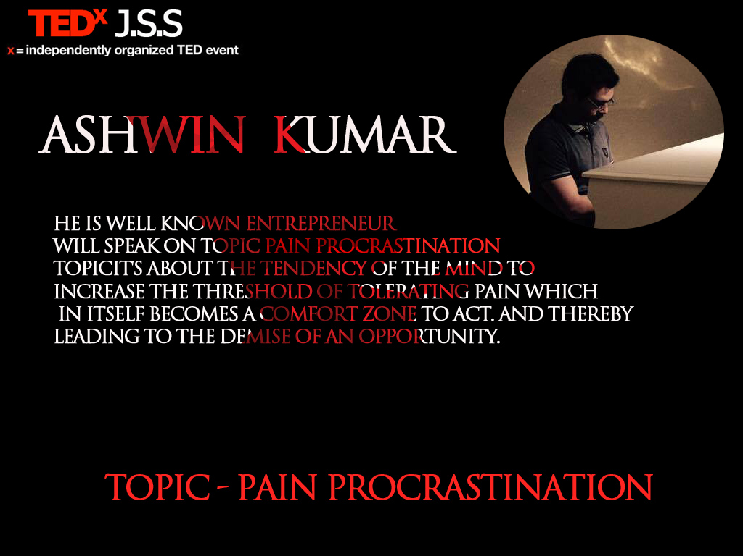

Slide 8


Slide 9


Slide 10


Slide 11


Slide 12
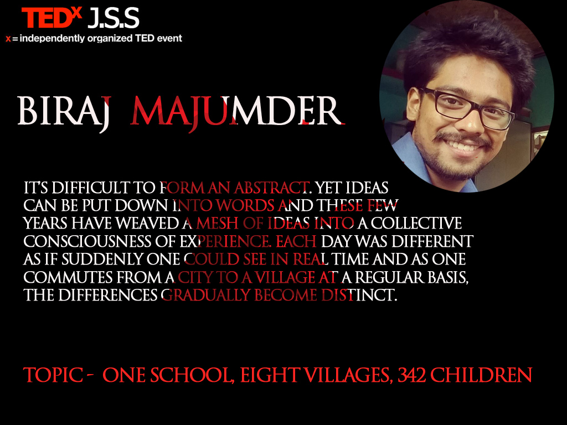

Slide 13

MANAGEMENT OF THE
EVENT

Slide 14
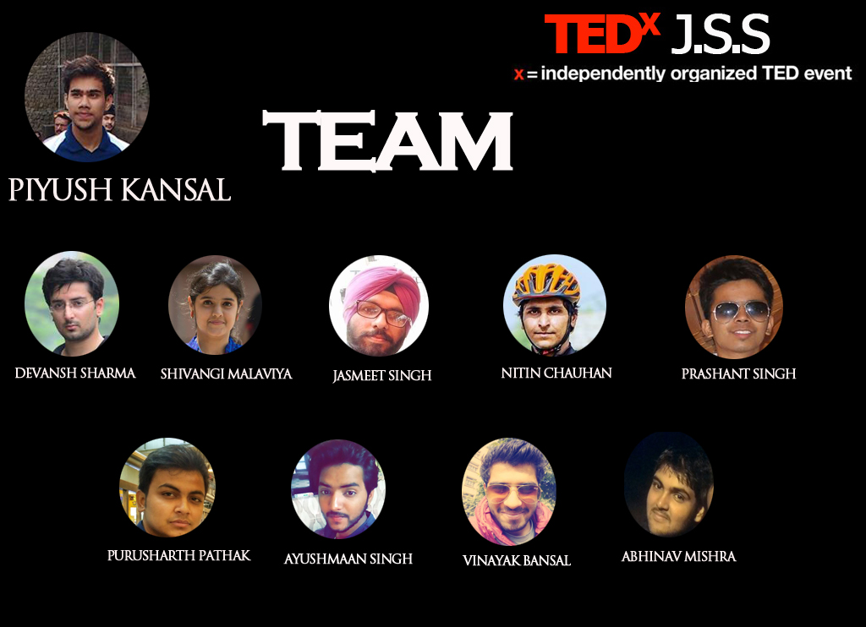

Slide 15
END

